Slide 1

Real Estate House Price Prediction Website
Hayley , Catherine , Nasrin , franco

Slide 2
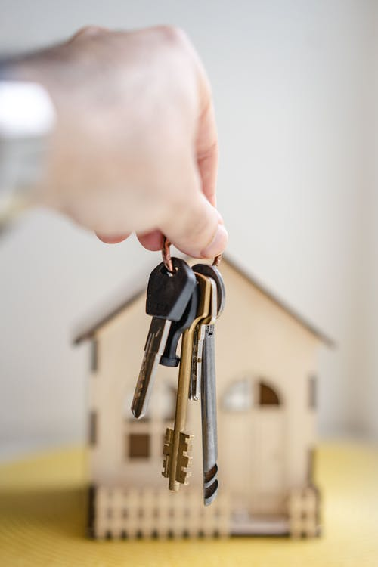
Problem Statement
House prices in Melbourne has gone crazy over time, we are interested to understand the relationship between different house features and how they are used to predict house price.
This is intended for home buyer / seller / real estate agent use

Slide 3

Requirements
Operating environment
Language - Python / JavaScript / HTML / CSS3
Server - Python / Flask
Visualisation - Tableau
User - Web Browser

Slide 4

Hypothesis
The analysis is based on the factors that could potentially affect the house price:
Hypothesis 1 - The distance from CBD has direct correlation to house prices regardless of the region.
Hypothesis 2 – The more schools are nearby, the more expensive is the house prices.
Hypothesis 3 - Crime rate affects the market prices indirectly. The higher the crime rate, the lower the house prices.
Hypothesis 4 - No of Rooms , Bathrooms , Car park have direct impact on the house prices.

Slide 5
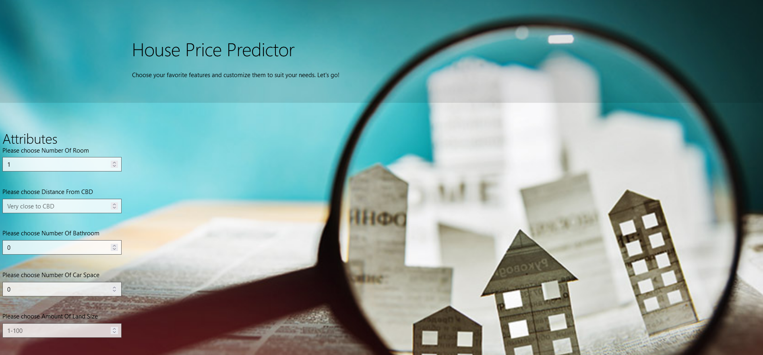
Application & Demo
We used python and flask to build the website and testing the results. We created a JSON map of features and values to allow user to freely choose. Once they make the request, the application will receive and return a response containing the predicted price.

Slide 6

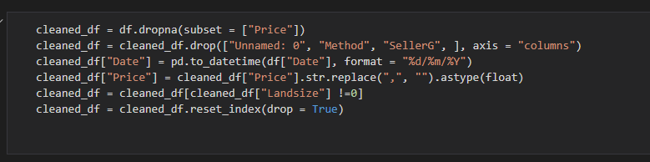
Data Cleaning
For the model to learn and train properly, we cleaned the data to ensure that all 0 and Nan are removed from the dataset.
Next, some columns were formatted to the proper sign to avoid any error.
Also removed some rows that has the 0 values as we deemed those info as inaccurate.

Slide 7

Machine Learning (NASRIN) Decision Tree
We train the model with 3 different ML models, that includes Decision Tree, Logistic Regression and Random Forest.

Slide 8

Logistic Regression

Slide 9
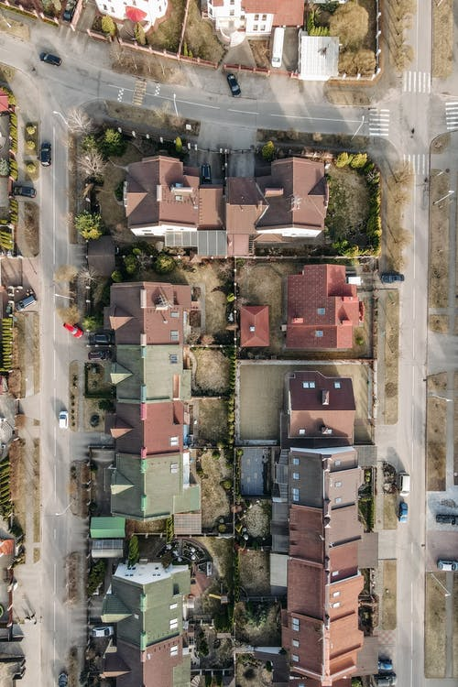
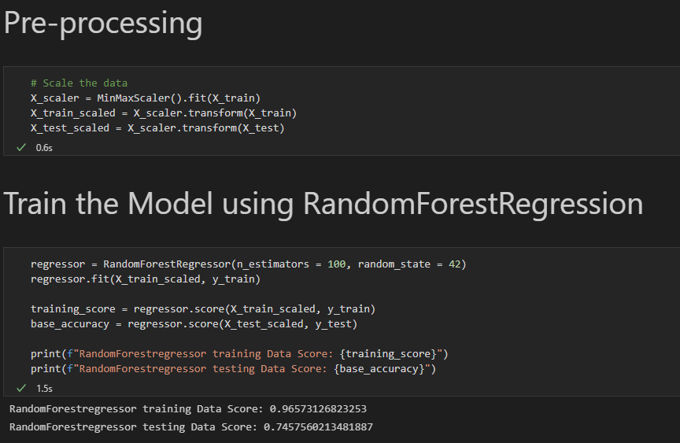
Machine Learning (FRANCO) Random Forest

Slide 10
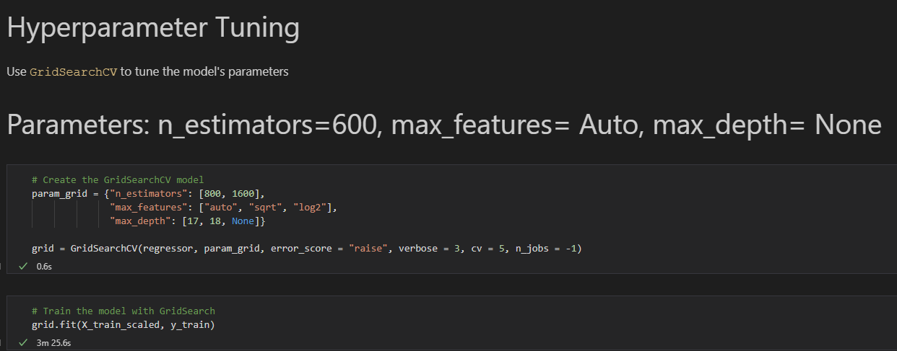
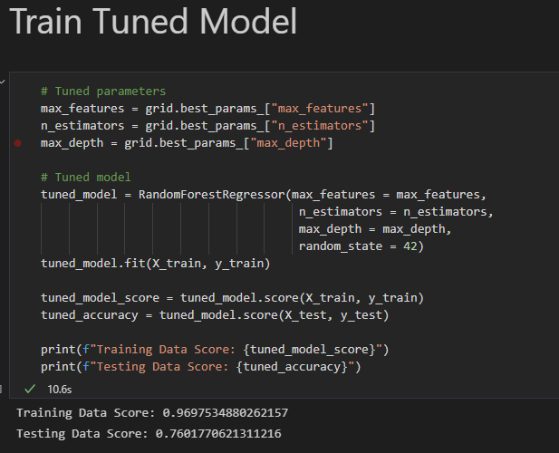
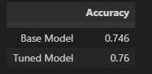
Random Forest continued Random Forest EXPLANATION?

Slide 11

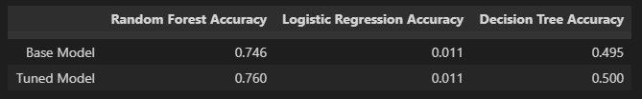
Model Comparison
Reason why we choose this?
What brings you to this decision?

Slide 12
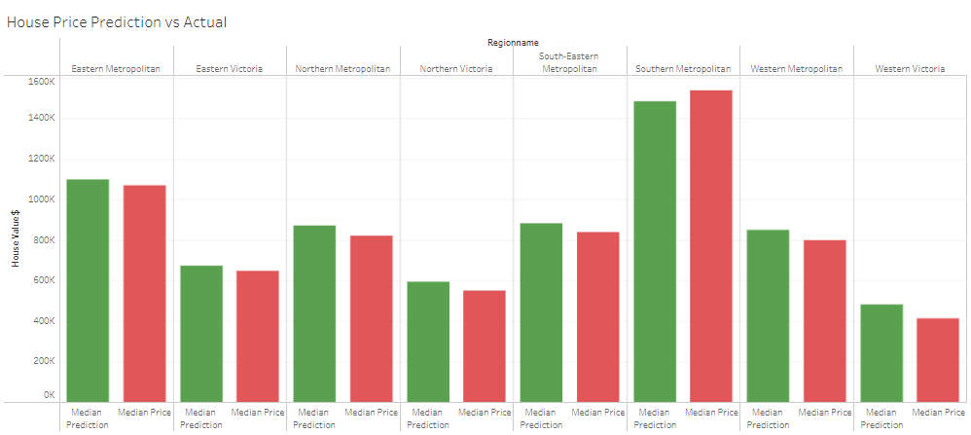
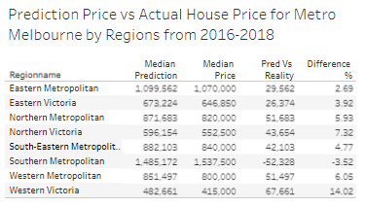
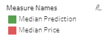
Prediction vs Actual
https://public.tableau.com/authoring/FinalProject_16428453496070/Analysis#1

Slide 13
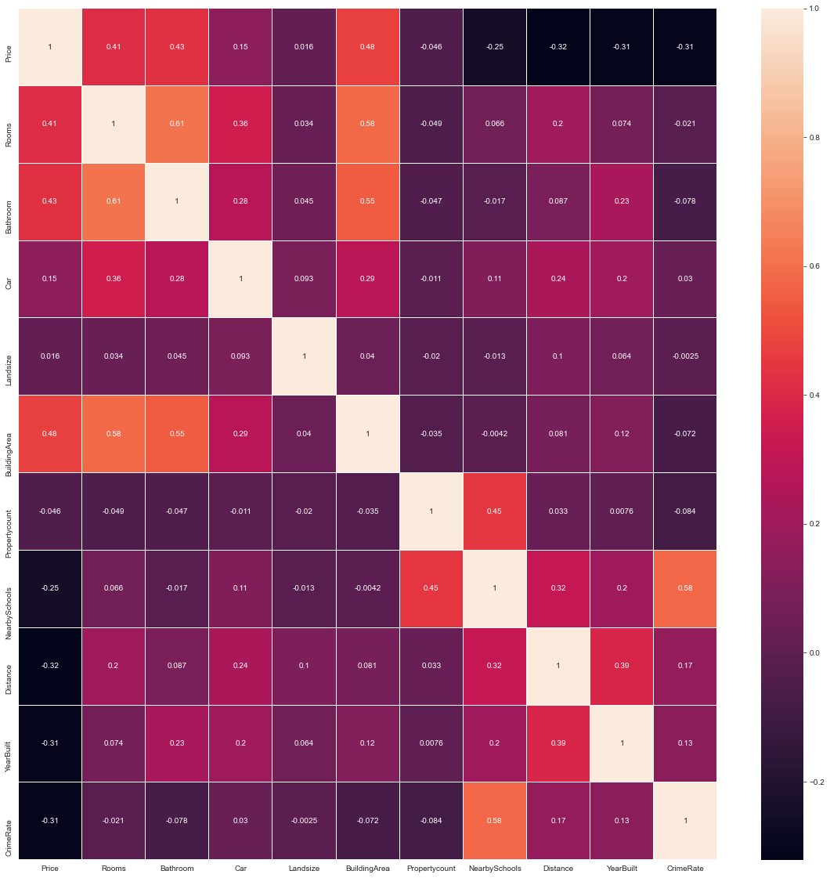
Observation from ML algorithm
Main factors that have positive relationship:
No of rooms
No of bathrooms
No of car park
Land size
Building area

Slide 14
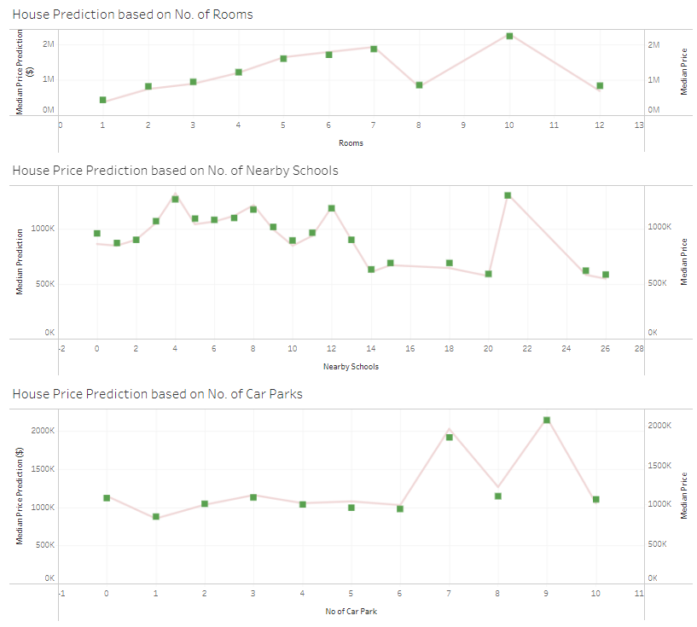
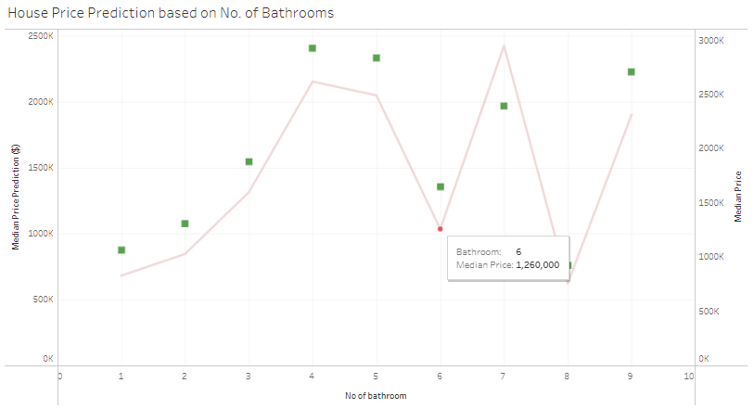
Prediction vs Actual (tableau)
https://public.tableau.com/authoring/FinalProject_16428453496070/Analysis#1

Slide 15

Findings & Summary
- actual and prediction

Slide 16

Conclusion (CATHERINE)

